Slide 1
Gen AI Enabled Green Coding Solution
30 May 2025
Rahul Dev Jangra
Emp: 128441

Slide 2
Idea – Green IT Across Tech Value Chain
Ambition : Most of the Customers have Net Zero Target by ~2040 to support the Sustainability.
TCS has Net Zero target by 2030
There is increased demand for bringing in Green IT principles. There are options of bringing sustainability offerings. For e.g.
Cloudification is going to directly influence sustainability goals
Green IT incl Green Coding, Optimized developments and reducing vulnerabilities
The Vision is to create a Gen AI accelerator which can help finding vulnerabilities related to Green Coding principles (using plugins) and alert developers to follow green coding principles. The tool can be platform agnostic.
Following are few of features which can be checked as part of accelerator:
Code Performance issues or prospect issues in the legacy code
Lean coding Principles
Virtual machines/Containerization
Bad design/Technical Debt
Use energy-efficient libraries and frameworks
Efficient algorithms and data structures
Reduce power consumption during the debugging process

Slide 3
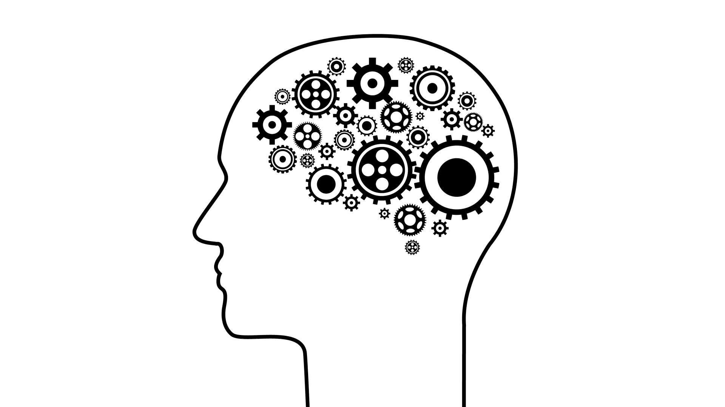


Solution Approach – Option1
Create an API based tool which can work as Green Coding Reviewer for multiple applications/technologies based on Gen AI (LLM)
Green Coding Defects
PEGA
Code Snippet
Mendix
REST API
Analysis
Reasoning
Azure Open AI
Amazon Bedrock
GCP
TCS Fine Tuned LLM ?
Custom
API
Apply Green Coding
Plug-Ins
Python
Agentic
Approach
Building & Training Generative AI Model
(LLM/Custom Model)
JAVA
LLM Training for Energy Efficiency : Data Input and Preparation, Data Ingestion, Data Cleaning, Normalization, Chunking, Tokenization, Data Loading, Loss Calculation, Hyperparameter Tuning, Parallelization and Resource Management, Model Parallelization, Gradient Checkpointing, Iterations, Monitoring
Revised Code

Slide 4

Option2: Installable Utility for each Low Code-No Code Platform
Improve Green Coding Coverage
When run on an application, the tool highlights for review the Green Coding design decisions Powered by Gen AI GPT4/LLM/Custom AI Models
Pega provides integrations with Azure OpenAI Service, Vertex AI, and Amazon AWS Bedrock to access various LLMs like ChatGPT, Gemini, Llama, and Claude.
Improvement
Suggestions
SelectApp
Select
Rulesets
Apply Green Coding
Plug-Ins
Agentic
Approach
Invoke Pega Gen AI
Process Flow
Invoke LLM (Options:)
Amazon Bedrock
GCP – Vertex AI
Grok.AI
Llama
View
Results
Process
Results
Approach
Sample Flow for Pega
Take a Back-Up and Database Point Restore of the environment before installation
Login to Pega Designer Studio & Import utility
Run the Utility which Scan the database and Invoke Pega OOTB LLM (Pre-trained for Green Coding) and finds the observations and violations.
Observations are listed in Report structure that which can be saved for offline analysis
Agentic Approach provides suggestions for Green Code and once accepted will overwrite the previously developed Code
TCS Confidential

Slide 5

GLOBAL MARKET REACH ~$100B+
Growth by 2030
Growing Demand
Regulatory and Policy support
Tech advancements
Funding for sustainable business
Resource Efficiency
Market Trends
FUTURE
Euro 4069 million
India Market Reach
23%
Market Segment Growth EU
15%
CAGR
Overall
MM
Revenue Increase
Effort required to build MVP solution ~3 months and can be taken to Marketplace
5
TCS Confidential
Sept 2023

Slide 6
The TCS commitment
In it for good.
We take a long-term view, building relationships that endure, leading to mutual growth and sustainable outcomes.
Bring everything.
When you are out to change your world, you need a partner who can combine every resource in their armory with an utter determination to succeed. Ideas magnified and value multiplied, at global scale.
Know-how.
With TCS, you experience certainty. We are a knowledge network of the smartest minds and practitioners who apply concept to context for real outcomes.
Master the journey.
Along with certainty, you also need partners who can deal with
uncertainty. We provide the agility and continuity you need to navigate perpetual change.
Digital transformation requires a holistic approach with intelligent solutions

